Slide 1
Out&About
Getting you things to do wherever you are

Slide 2

User Story: Ever felt this way before?

Slide 3
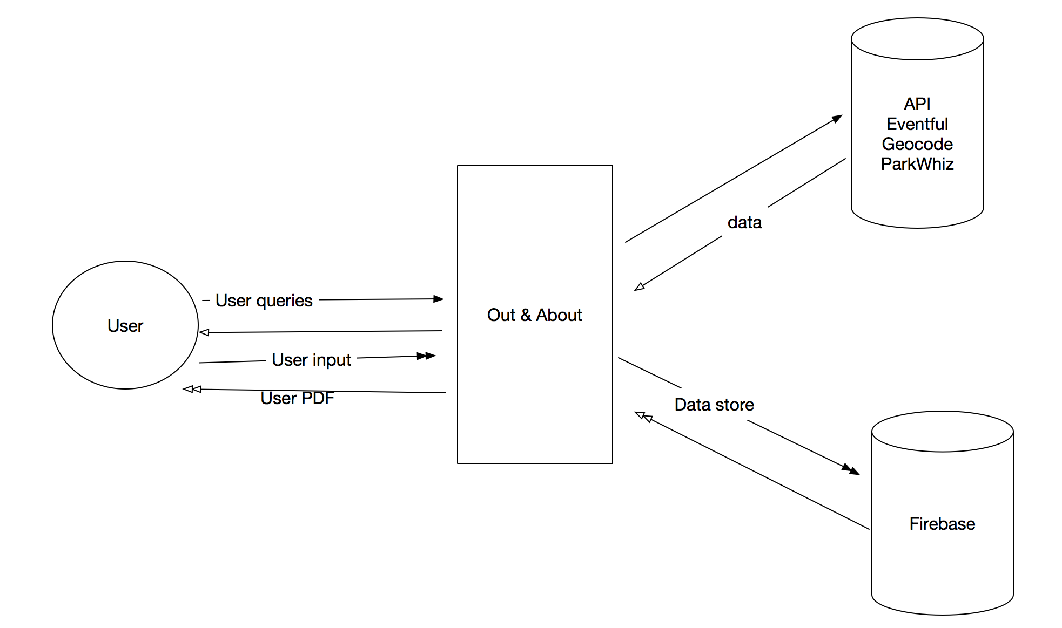
Out & About Concept

Slide 4
App Demo

Slide 5
HTML/CSS snippet
Notes:
Des

Slide 6
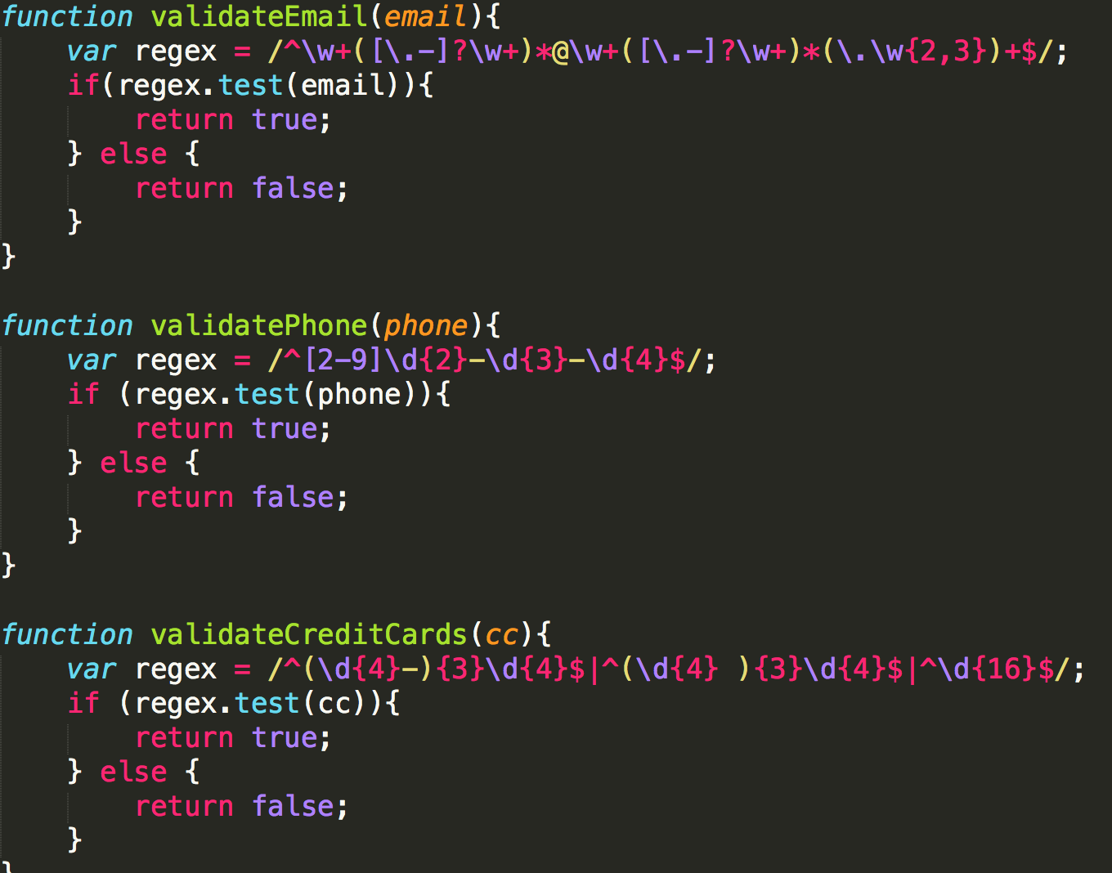
User validation
Notes:
Vincent

Slide 7
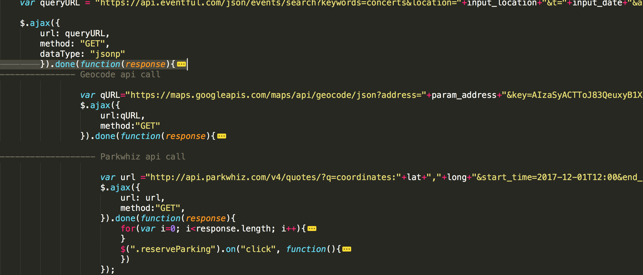
API calls
Notes:
joyce

Slide 8
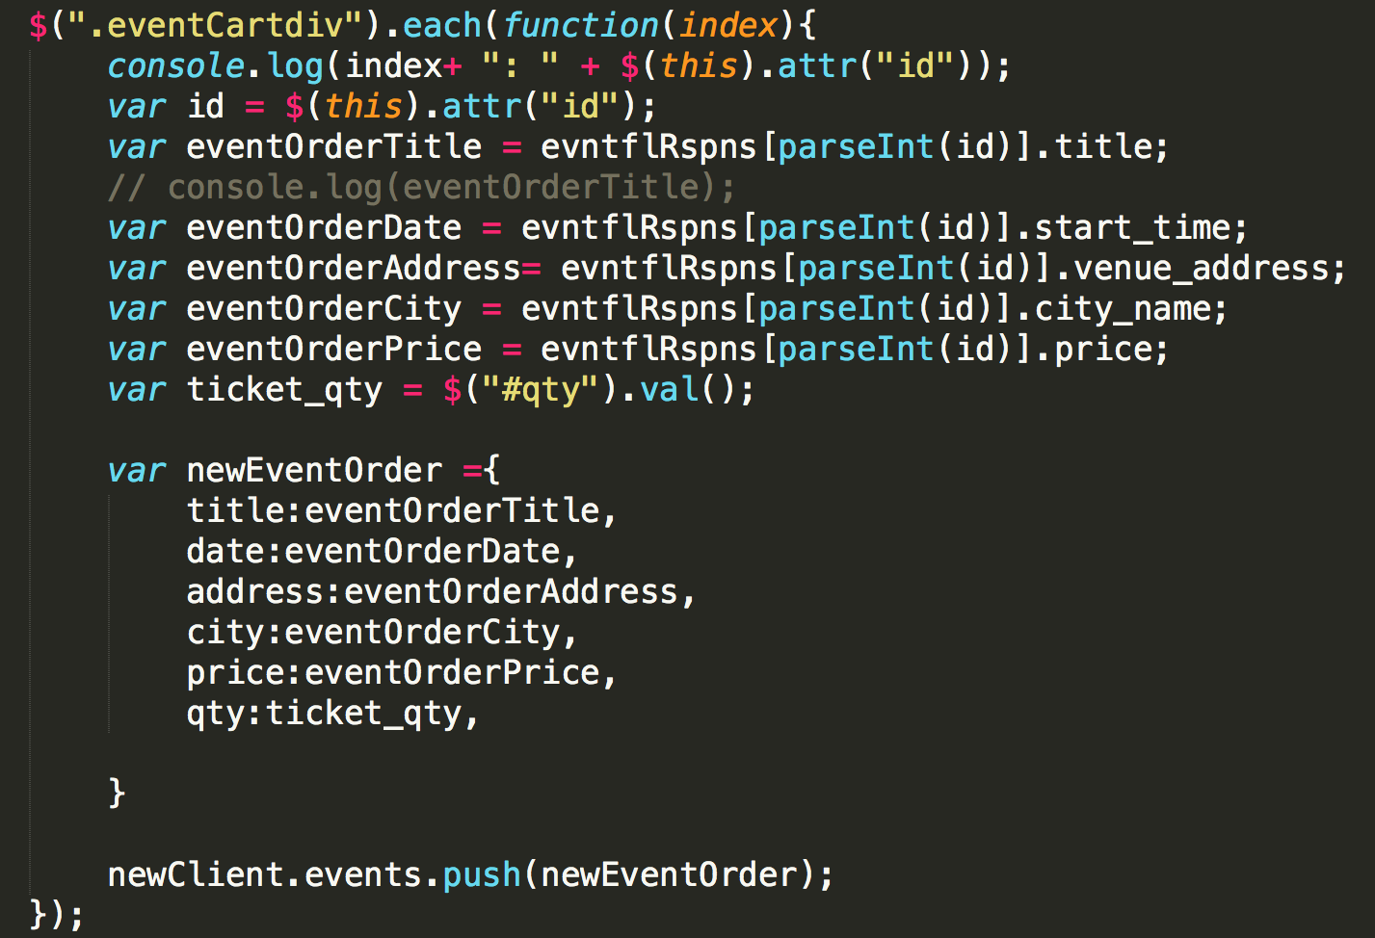
Firebase
Notes:
mary

Slide 9
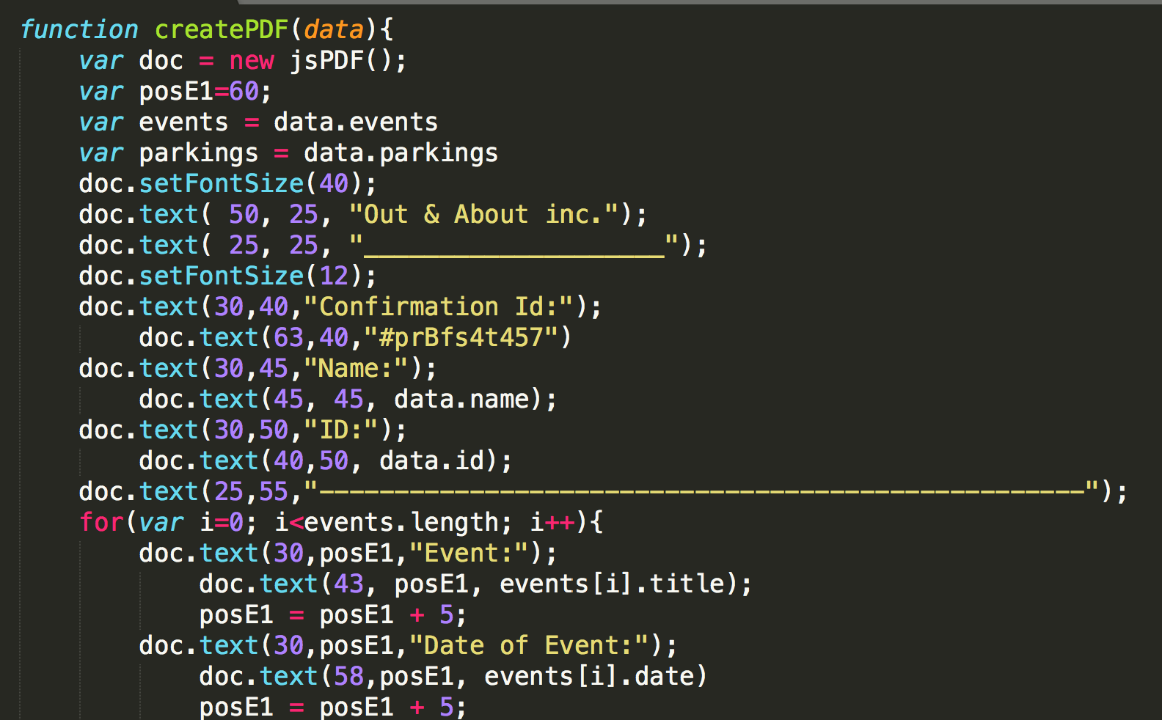
Features

Slide 10
Limitations
Eventful Api’s latitude and longitude does not match how ParkWhiz consume lat/long (Geocode)
Park Whiz Api does not work in small Cities. It returns empty data.
No billing technology integrated.
No data available if tickets are sold out.
No available API that will show a nearby garage for an event.

Slide 11
Directions for future development
Calculations of total prices.
Account logins so user can eventually save their events.
Transfer to mobile app

Slide 12




That’s all folks—team 5

